Slide 1
ORTHOPEDIC NURSING
By
MISS.WANYONYI

Slide 2
COURSE OUTLINE
Broad and specific objective
Definition of terminologies
Review of anatomy and physiology; Bone development ,functions of bones,
Joints; Types
Disorders of bones; scoliosis, kyphosis, lumbar lordosis
Metabolic disorders of the bone
Osteoporosis
Osteomalacia
Bone tumors', osteomylitis

Slide 3
Course outline
Fractures
Definition, classification,
specific types of fractures
Bone healing; areas of bone healing
Process of bone healing
Factors enhancing bone healing
Principles of fracture management
Traction; Definition, types, indication,
principles of effective traction
Specific care of patient on traction

Slide 4
Course outline
Cast and splints; definition, purpose
Nursing management of a patient on cast and splints
Complications of fracture; early and delayed
Soft tissue injuries; contusion, sprain, strain
Joint disorders
Rheumatoid arthritis, osteoarthritis, joint dislocation, Gout
Amputation, Definition, indication, levels,
Pre-operative and post-operative care

Slide 5
Review of A & P
The musculoskeletal system includes the bones, joints, muscles, tendons, ligaments, and bursae of the body
Bone is a type of connective tissue.
It is made up of water, living cells, calcium and phosphorus as its main components.
The cells making up the bone are
osteoblast: bone-forming cell
osteoclast: bone resorption cell
osteocyte: mature bone cell

Slide 6
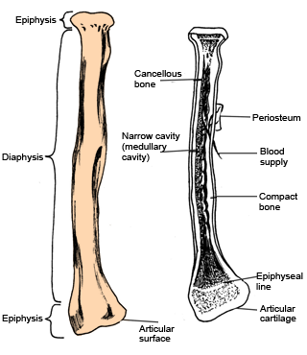
You have.
.

Slide 7
The bone is the hardest tissue in the body and when fully developed comprises of:
Water 20 %
Organic material 30% to 40%
Inorganic materials 40% to 50%
Inorganic material mainly constitutes of mineral salts especially calcium and phosphates.
Organic materials comprise of bone cells and tissues
There are two types of bone tissue - compact and cancellous. Bones are almost completely covered by periosteum which is a vascular fibrous membrane. Periosteum gives attachment to muscles.
Types of Bones
Bones are classified as short(metarcapols), irregular, flat or sesamoid(sternum), long bones e.g. femur

Slide 8
BONE DEVELOPMENT(osteogenesis)
This is the process of bone formation that begins before birth and is not completed until age 25 years. Long, short and irregular bones develop from cartilage models.
Ossiﬁcationis the process by which the bone matrix (collagen ﬁbers and ground substance) is formed and hardening minerals (eg, calcium salts) are deposited on the collagen ﬁbers.
results from deposits of both organic and inorganic bone elements.
This further develops allowing for a clear demarcation of the diaphysis.
Osteoblasts and osteoclasts are involved in bone

Slide 9
THE SKELETON
The human skeleton is divided into two main parts:
the axial skeleton and
the appendicular skeleton.
The axial skeleton refers to the central, while appendicular refers to the attachments.
The axial skeleton is made up of the skull, the vertebral column, the ribs and the sternum.
The appendicular skeleton consists of the shoulder girdle, upper limbs, pelvic girdle and lower limbs.
The total number of bones in the human body is at least 206.

Slide 10
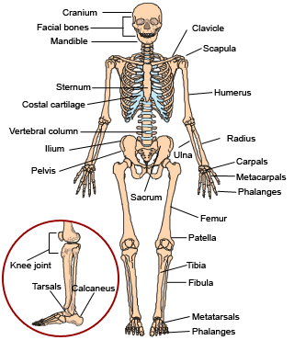
.

Slide 11
FUNCTIONS OF BONES
Provide the basic framework of the body
Provide points of attachments to muscles and tendons
Form a reservoir for calcium
Permit movement of the body as a whole by forming joints
Form boundaries of many cavities, which provides protection to organs within
Contain red bone marrow, which is involved in the production of blood cells

Slide 12
JOINTS
Def: they are points in the body at which bones attach to each other. They form the points at which many movements can be made and positions changed.
3 main types of joints:
Fibrous joints, are fixed and immovable joints. E.g joints between skull bones (or sutures).
Cartilaginous joints, are slightly movable. They have cartilage between two bones. E.g joints between the vertebral bones.
Synovial (diarthrosisl) joints, are freely movable. Further subdivided into ball and socket joints, hinge joints, gliding joints, pivot and saddle joints.

Slide 13
MOVEMENTS OF JOINTS
Flexion: bending forward and backward. E.g knee joint.
Extension: straightening or bending backwards.
Abduction: movement away from the midline. E.g moving the arm or leg away from the body laterally.
Adduction: movement towards the middle of body.
Eversion: turning the sole of the foot outwards.
Inversion: turning the sole of foot inwards.
Supination: turning the palm up.
Pronation: turning the palm downwards.
Rotation: movement around the long axis. E.g the lower limb or the upper limb.
Circumduction: a combination of adduction, flexion and extension.

Slide 14
DISORDERS OF BONES
Results from
altered growth and development,
disordered metabolism,
neoplasm,
injuries and their complications.
The disorders occurring during growth and development include femoral ante-version where there is internal torsion or rotation of the femur and toeing-out of the foot with the foot flat and toes spread out. Many of the conditions resolve by themselves while a few may need surgery.

Slide 15
SCOLIOSIS
Scoliosis: is lateral deviation of the spinal column.
Causes
Idiopathic
Certain diseases e.g poliomyelitis
Manifested by
Uneven shoulders and a
Prominent scapula,
Asymmetry of the flanks and
Asymmetry of the thoracic cage.
Rip humps

Slide 16
Kyphosis : an exaggeration in the curvature of the thoracic spine.
This may lead to a change in the volume of the thoracic space thus affect the functional lung capacities.
Lumbar lordosis: an exaggeration in the curvature of the lumbar spine(swayback). This normally occurs during growth and development.

Slide 17
OSTOEPOROSIS
Def: a disorder in which the rate of bone reshaping (resorption) is greater than the rate of formation.
This results in a loss of organic matrix and mineral content. The bone then becomes brittle, fragile and fractures easily. It is common among the elderly, post-menopausal women, people with Cushing’s syndrome and those who are on steroid treatment.
The manifestations of osteoporosis are pain and spontaneous fractures. In some cases, wedging and collapse of vertebrae causes loss of height. It may also lead to kyphosis

Slide 18
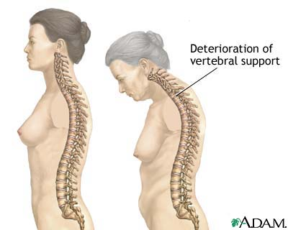

Slide 19
Major Risk Factors
Female Sex
Age
Menopause
Race

Slide 20
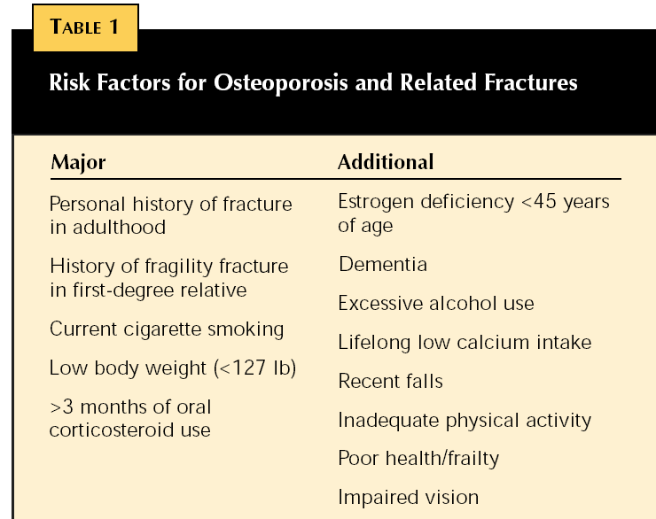
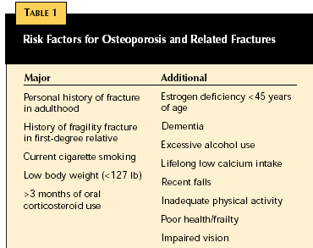

Slide 21
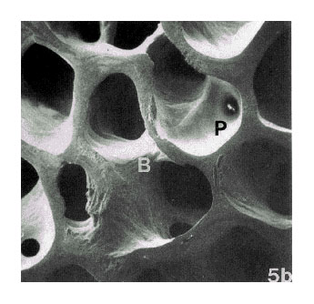
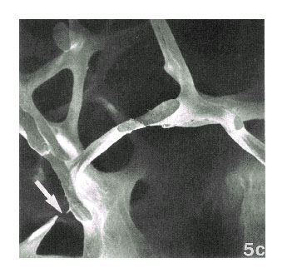
Normal & Osteoporotic Bone Architecture
Normal Bone
Osteoporotic Bone
Reproduced from J Bone Miner Res 1986;1:15-21 with permission of the American Society for Bone and Mineral Research. © 1986 by Massachusetts Medical Society. All rights reserved.

Slide 22
Causes
Diabetes
Rheumatoid arthritis
Leukemia
Pathophysiology In the normal bone forming process, bone remodeling occurs at the same pace as bone resorption. In osteoporosis, there is rapid bone loss. This leads to thinning of the lamellar with deformity and later collapse. The bone may easily fracture.

Slide 23
Pathophysiology
Genetics
• Caucasian or Asian
• Female
• Family history
• Small frame
Age
• Post-menopause
• Advanced age
• Low testosterone in men
• Decreased calcitonin
Physical exercise
• Sedentary
• Lack of weight-bearing exercise
• Low weight and body mass index
Predisposes to low bone mass
Hormones (estrogen, calcitonin, and testosterone) inhibit bone loss. Reduces nutrients needed for bone remodeling.
Bones need stress for bone maintenance

Slide 24
Lifestyle choices
• Caffeine
• Alcohol
• Smoking
• Lack of exposure to sunlight
Medications e.g., corticosteroids, anti-seizure medications, heparin, thyroid hormone
Co-morbidity e.g., anorexia nervosa, hyperthyroidism, mal-absorption syndrome, renal failure
Nutrition
• Low calcium intake
• Low vitamin D intake
• High phosphate intake (carbonated beverages)
• Inadequate calories
Reduces osteogenesis in bone remodeling
Affects calcium absorption and metabolism
Reduces nutrients needed for bone remodeling

Slide 25
Risk factors
Individual Risk Factors
• Female, Caucasian, non-Hispanic or Asian
• Increased age
• Low weight and body mass index
• Estrogen deficiency or menopause
• Family history
• Low initial bone mass
• Contributing, coexisting medical conditions (eg, celiac disease)
and medications (eg, corticosteroids, antiseizure medications)
Lifestyle Risk Factors
• Diets low in calcium and vitamin D
• Cigarette smoking
• Use of alcohol and/or caffeine
• Lack of weight-bearing exercise
• Lack of exposure to sunshine

Slide 26
Risk-Lowering Strategies
• Increased dietary calcium and vitamin D intake
• Smoking cessation
• Alcohol and caffeine consumption in moderation
• Regular weight-bearing exercise regimen
• Walk or exercise out of doors

Slide 27
Diagnosis
History and clinical features
X-ray
Quantitative ultrasound studies (QUS) of the heel
Clinical Features
Acute onset back pain in low thoracic region cause vertebral fracture
Kyphosis (postural changes)
Management
Prevention of the condition is through early administration of calcium supplements to encourage bone strengthening. Others include vitamin D, Fluoride.
Give health messages about dangers of smoking and need to avoid it.
Women approaching menopause may require assessment for suitability of hormone replacement therapy.

Slide 28
Life style changes including quitting cigarette smoking, curtailing alcohol intake, exercising regularly, and consuming a balanced diet with adequate calcium and vitamin D;
Medications that stop bone loss and increase bone strength, such as alendronate (Fosamax), risedronate (Actonel), raloxifene (Evista), ibandronate (Boniva), calcitonin (Calcimar);
Medications that increase bone formation such as teriparatide (Forteo).

Slide 29
OSTEOMALACIA AND RICKETS
These terms refer to the same process occurring at different ages. In both cases, there is a deficiency of vitamin D. characterized by inadequate mineralization of bone.
If the deficiency occurs before fusion of the epiphyseal plates then the bones get deformed, but if fusion has already occurred, then the bones will bend easily.
Rickets therefore occurs in children and osteomalacia in adults.
Both conditions are caused by malabsorption syndromes, lack of exposure to sunlight and excess secretion of vitamin D.

Slide 30
PATHOPHYSIOLOGY OF OSTEOMALACIA
The primary defect in osteomalacia is a deficiency of activated vitamin D (calcitriol), which promotes calcium absorption from the gastrointestinal tract and facilitates mineralization of bone.
The supply of calcium and phosphate in the extracellular fluid is low. Without adequate vitamin D, calcium and phosphate are not moved to calcification sites in bones.
Osteomalacia may result from failed calcium absorption (e.g, mal-absorption syndrome) or from excessive loss of calcium from the body. Gastrointestinal disorders e.g chronic pancreatitis, in which fats are inadequately absorbed cause osteomalacia through loss of vitamin D (along with other fat soluble vitamins) and calcium, the latter being excreted in the feces with fatty acids.

Slide 31
Liver and kidney diseases can produce a lack of vitamin D because these are the organs that convert vitamin D to its active form.
Severe renal insufficiency results in acidosis. The body uses available calcium to combat the acidosis, and PTH stimulates the release of skeletal calcium in an attempt to reestablish a physiologic pH. During this continual drain of skeletal calcium, bony fibrosis occurs and bony cysts form.
Hyperparathyroidism leads to skeletal decalciﬁcation and thus to osteomalacia by increasing phosphate excretion in the urine.
Prolonged use of antiseizure medication (eg, phenytoin,

Slide 32
ct
The malnutrition type of osteomalacia (deﬁciency in vitamin D often associated with poor intake of calcium
Clinical manifestations
there is softening and weakening of the skeleton, causing pain, tenderness to touch, bowing of the bones, and pathologic fractures. On physical examination, skeletal deformities (spinal kyphosis and bowed legs) give patients an unusual appearance and a waddling or limping gait.
muscle weakness, and unsteadiness
Laboratory studies show low serum calcium and phosphorus levels and a moderately elevated alkaline phosphatase concentration.

Slide 33
Management of osteomalacia
The underlying cause of osteomalacia is corrected if possible.
If caused by malabsorption, increased doses of vitamin D, along with supplemental calcium, are usually prescribed.
Exposure to sunlight.
If it is dietary in origin, a diet with adequate protein and increased calcium and vitamin D is provided. i.e milk, cereals
. Some persistent orthopedic deformities may need to be treated with braces or surgery
Physical, psychological, and pharmaceutical measures are used to reduce the patient’s discomfort and pain. When assisting the patient to change positions, the nurse handles the patient gently, and pillows are used to support the body.

Slide 34
CARE OF THE ADULT WITH OSTEOPOROSIS, OSTEOMALACIA AND RICKETS
The prevention of osteoporosis focuses on adequate calcium intake and calcium supplementation..
Oestrogen replacement therapy after menopause is used to prevent osteoporosis among post-menopausal women.
Calcitonin treatment, which acts by blocking the effects of the parathyroid hormone on bone resorption. The drug etidionate disodium also inhibits bone resorption.
Weight bearing exercises to prevent osteoporosis.

Slide 35
Keep patients with osteoporosis ambulated to prevent further loss of bone substance as a result of immobility.
Institute measures to avoid pathological fractures in patients with osteoporosis.
Health education on the prevention of home accidents. Those at risk should avoid walking on slippery floors, and should wear shoes with a firm sole.
Supplementation of vitamin D.
Calcium and phosphorous intake may also be supplemented after proper investigation.

Slide 36
BONE TUMORS
They may be primary tumors or metastatic tumors from primary cancers elsewhere in the body
Benign tumors of the bone and soft tissue are more common. generally are slow growing and well circumscribed and present few symptoms,
Benign primary neoplasms of the musculoskeletal system include osteochondroma, enchondroma, bone cyst (eg, aneurysmal bone cyst), osteoid osteoma, rhabdomyoma, and ﬁbroma.
Osteochondroma is the most common benign bone tumor. It usually occurs as a large projection of bone at the end of long bones
A painful tumor that occurs in children and young adults is the osteoid osteoma.
Giant cell tumors (osteoclastomas) are benign for long periods

Slide 37
MALIGNANT BONE TUMORS
Primary malignant musculoskeletal tumors are relatively rare and arise from connective and supportive tissue cells (sarcomas) or bone marrow elements.they include multiple myeloma; osteosarcoma, chondrosarcoma,, and ﬁbrosarcoma. Soft tissue sarcomas include liposarcoma, ﬁbrosarcoma of soft tissue, and rhabdomyo sarcoma.
The usual tumor sites include the pelvis, femur, humerus, spine, scapula, and tibia.
METASTATIC BONE DISEASE Metastatic bone disease (secondary bone tumor) is more common than any primary bone tumor.

Slide 38
The conditions associated with bone tumours are infections, pathological fractures,inflammatory conditions or developmental.
Manifestations of bone cancer include
bone pain that lasts over a week and
unexplained swelling over a particular bone.
warm skin over the affected bones and
prominent veins.
Weight loss, malaise, and fever may be present.
Bone tumours are rare in adults but if present, they rapidly metastasize and cause bone destruction and organ involvement e.g multiple myeloma.

Slide 39
Management
The goal of primary bone tumor treatment is to destroy or remove the tumor.
This may be accomplished by surgical excision,Chemotherapy, used to suppress plasma cell growth in the bone marrow.
Steroids are also given to these patients.
However, both these management methods increase the patient’s susceptibility to infection thus, good infection prevention and control should be practiced.
In osteoblastoma and sarcoma, chemotherapy, surgery and radiation may improve survival rates.
The treatment of metastatic bone cancer is palliative. The thera- peutic goal is to relieve the patient’s pain and discomfort while promoting quality of life.

Slide 40
management of metastatic bone tumour
Pain must be assessed accurately and managed with adequate and appropriate opioid, nonopioid analgesics
structural support and stabilization are needed to prevent pathologic fracture and pain by prophylactic internal ﬁxation.
Hypercalcemia from breakdown of bone Treatment includes hydration with IV administration of normal saline solution, diuresis, mobilization, and medications such as bisphosphonates,, and calcitonin.
Because inactivity leads to loss of bone mass and increased calcium in the blood, the nurse assists the patient to increase activity and ambulation.
Blood product transfusions restore hematologic factors.

Slide 41
Goals of management.
Ensuring satisfactory pain relief
Enabling the patient to maintain preferred activities
Encouraging the patient to accept body image changes resulting from chemotherapy radiation and surgery
Decreasing the possibility of injury
Educating the patient on disease progression and prognosis
Paying attention to pathological fractures, spinal cord compression and limb amputation. This ensured through
the affected extremities must be supported and handled gently. Use of External supports, Prescribed weight-bearing restrictions must be followed. use assistive devices safely

Slide 42
Ct…
monitoring and managing potential complications i.e
Delayed Wound Healing, Inadequate Nutrition
Osteomyelitis and Wound Infections Hypercalcemia. The nursing care of a patient who has undergone excision of a bone tumor include Vital signs are monitored; blood loss is assessed; and monitor for complications i.e deep vein thrombosis, pulmonary emboli, infection
promoting coping skills The nurse encourages the patient and family to verbalize their fears, concerns, and feelings. They need to be supported as they deal with the impact of the malignant bone tumor.

Slide 43
OSTEOMYELITIS
is an infection of the bone.
The bone becomes infected by one of three modes:
• Extension of soft tissue infection (e.g., infected pressure or vascular ulcer, incisional infection)
• Direct bone contamination from bone surgery, open fracture, or traumatic injury (e.g., gunshot wound)
• Hematogenous (blood borne) spread from other sites of infection (e.g., infected tonsils, boils, infected teeth, upper respiratory infections). Patients who are at high risk include those who are poorly nourished, elderly, or obese. impaired immune systems, those with chronic illness (eg, diabetes, )and those receiving longterm corticosteroid therapy.

Slide 44
Pathophysiology
Staphylococcus aureus causes 70% to 80% of bone infections. Other pathogenic organisms include Proteus and Pseudomonas species and Escherichia coli.
The initial response to infection is inflammation, increased vascularity, and edema. After 2 or 3 days, thrombosis of the blood vessels occurs in the area, resulting in ischemia with bone necrosis.
The infection extends into the medullary cavity and under the periosteum and may spread into adjacent soft tissues and joints. Unless the infective process is treated promptly, a bone abscess forms. The resulting abscess cavity contains dead bone tissue (the sequestrum), which does not easily liquefy and drain. Therefore, the cavity cannot collapse and heal, as occurs in soft tissue abscesses.
New bone growth (the involucrum) forms and surrounds the sequestrum. Although healing appears to take place, a chronically infected sequestrum remains and produces recurring abscesses throughout the patient’s life. This is referred to as chronic osteomyelitis.

Slide 45
Clinical manifestations
When the infection is blood-borne, the onset is usually sudden, occurring often with the clinical manifestations of
septicemia (e.g., chills, high fever, rapid pulse, general malaise).
The infected area becomes painful, swollen, and extremely tender.
constant, pulsating pain that intensifies with movement as a result of the pressure of the collecting pus.
. The area is swollen, warm, painful, and tender to touch.
The patient with chronic osteomyelitis presents with a continuously draining sinus or experiences recurrent periods of pain, inflammation, swelling, and drainage

Slide 46
Diagnosis
X-ray
Magnetic resonance imaging
Blood studies(elevated leukocyte levels and an elevated sedimentation rate)
Wound and blood culture studies(to identify appropriate antibiotic therapy)

Slide 47
Prevention
Elective orthopedic surgery should be postponed if the patient has a current infection (e.g., urinary tract infection, sore throat) or a recent history of infection.
During orthopedic surgery, careful attention is paid to the surgical environment and to techniques to decrease direct bone contamination.
Prophylactic antibiotics, administered to achieve adequate tissue levels at the time of surgery and for 24 hours after surgery.
Urinary catheters and drains are removed as soon as possible to decrease the incidence of hematogenous spread of infection.
Aseptic postoperative wound care reduces the incidence of superficial infections and osteomyelitis.
Prompt management of soft tissue infections reduces extension of infection to the bone.
When patients who have had joint replacement surgery undergo dental procedures or other invasive procedures (e.g., cystoscopy), prophylactic antibiotics are recommended.

Slide 48
Medical management
Antibiotic therapy depends on the results of blood and wound cultures.(I.V antibiotics3-6 weeks,oral for 2months)
Control pain by adminstering analgesics i.e diclofenac .
General supportive measures (e.g., hydration, diet high in vitamins and protein, correction of anemia) should be instituted.
The area affected with osteomyelitis is immobilized to decrease discomfort and to prevent pathologic fracture of the weakened bone.
Warm wet soaks for 20 minutes several times a day to increase circulation.

Slide 49
Surgical management
The infected bone is surgically exposed, the purulent and necrotic material is removed, and the area is irrigated with sterile saline solution.
Antibiotic-impregnated beads may be placed in the wound for direct application of antibiotics for 2 to 4 weeks. IV antibiotic therapy is continued.
In chronic osteomyelitis, antibiotics are adjunctive therapy to surgical debridement.
A sequestrectomy (removal of enough involucrum to enable the surgeon to remove the sequestrum) is performed.
Wound irrigation using sterile physiologic saline solution may be performed for 7 to 8 days.

Slide 50
Specific nursing activities include
assesses the patient for risk factors (eg, older age, dia- betes, long-term corticosteroid therapy) and for a history of pre- vious injury, infection, or orthopedic surgery
RELIEVING PAIN
The affected part may be immobilized with a splint to decrease pain and muscle spasm.
Elevation reduces swelling and associated discomfort
Adminster prescribed analgesics
IMPROVING PHYSICAL MOBILITY
of assistive devices such as crutches,
The joints above and below the affected part should be gently placed through their range of motion.

Slide 51
ct
CONTROLLING THE INFECTIOUS PROCESS
close monitoring of the patient,
promotion of drainage,
use of antibiotics,.
changes dressings using aseptic technique
use of fluids,
good nutrition to the patient diet high in protein and vitamin
patient education.
The patient and family must learn and recognize the importance of strictly adhering to the therapeutic regimen of antibiotics and preventing falls or other injuries

Slide 52
FRACTURES
Def: A fracture is any break in the continuity of bone.
Classification of Fractures
They are classified according to:
Location
Type
Direction or pattern of fracture line
1. Location Long bones can be described as having 3 parts; proximal, mid-shaft and distal. A fracture of the long bone is described in relation to its position in the bone.

Slide 53
2. Types of Fracture
This is in relation to its
communication to the environment,
degree of break in continuity of the bone,
character of fracture.
Pattern of fracture line
E.g, an open fracture(compound/complex) communicates with the environment because it penetrates the skin, while a closed fracture (simple)does not penetrate the skin.
Degree of break in a continuity of a bone e.g.
incomplete (green stick)-
complete- break across the entire cross-section of the bone and is frequently displaced
Character of fracture which is described as comminuted, impacted, segmental, etc.
The pattern of fracture line can be described as transverse, spiral, oblique, etc.

Slide 54
Clinical features
Pain at site of injury due to muscle spasm
Discoloration of the skin (ecchymosis) due to bleeding into tissues
Swelling due to hematoma formation
Loss of function due to pain and deformity
Deformity depending on force and muscle tissue surrounding muscles e.g. angulation, shortening of extremity.
Shortening: because of the contraction of the muscles that are attached above and below the site of the fracture.
Crepitus: When the extremity is examined with the hands, a grating sensation can be felt. It is caused by the rubbing of the bone fragments against each other.
Diagnosis
This is made from the history e.g. fall or trauma in road traffic accidents.
An x-ray examination confirms diagnosis.

Slide 55
Specific types of fractures
Avulsion: a fracture in which a fragment of bone has been pulled away by a ligament or tendon and its attachment.
Compression: a fracture in which bone has been compressed (seen in vertebral fractures)
Stress: a fracture that results from repeated loading without bone and muscle recovery

Slide 56
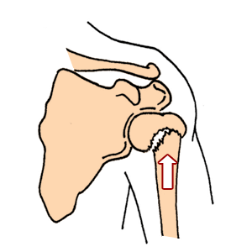
:
.
An impacted fracture bone fragment is driven into another bone fragment

Slide 57
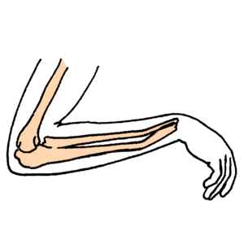
.
.
A green stick fracture a fracture in which one side of a bone is broken and the other side is bent

Slide 58
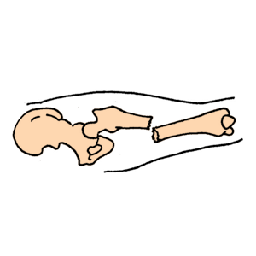
.
A closed fracture where there is no open wound

Slide 59
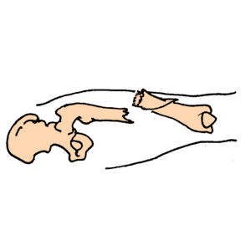
.
.
An open fracture where a wound in the skin communicates with the fracture.

Slide 60
Open fractures are graded according to the following criteria:
Grade I is a clean wound less than 1 cm long.
Grade II is a larger wound without extensive soft tissue damage.
Grade III is highly contaminated, has extensive soft tissue damage, and is the most severe.

Slide 61
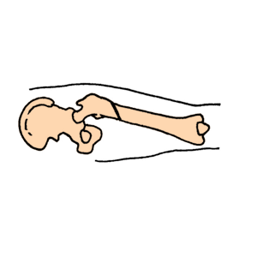
.
An extracapsular fracture – the bone is broken outside of the joint.

Slide 62
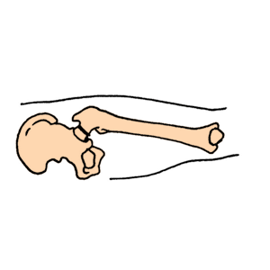
An intracapsular fracture - the bone is broken inside the joint.

Slide 63
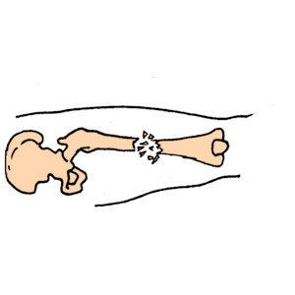
Comminuted fracture where the bone has splintered into fragments

Slide 64
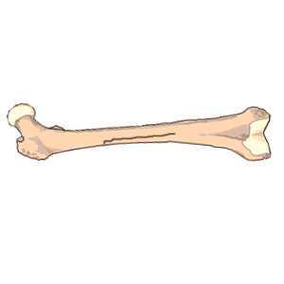
A longitudinal fracture where the break runs parallel with the bone.

Slide 65
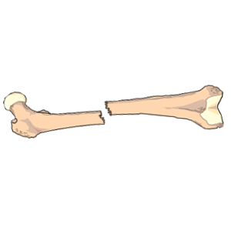
A transverse fracture - the break runs across the bone.

Slide 66
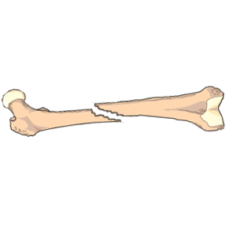
An oblique fracture occurs when the break runs in a slanting direction across the bone.

Slide 67
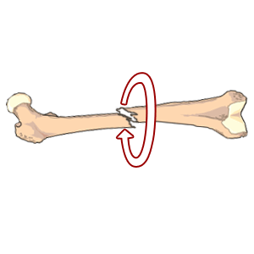
.
A spiral fracture is where the break coils around the bone

Slide 68
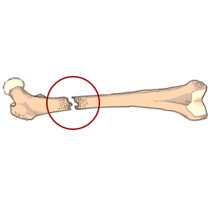
.
A pathologic fracture occurs when the break is at the site of bone disease.

Slide 69
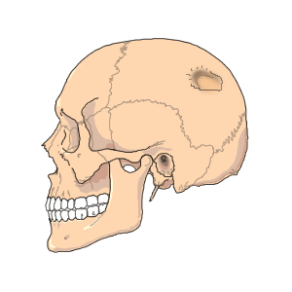
.
A depressed fracture occurs when a piece of the skull is broken off and driven inwards

Slide 70
BONE HEALING
Fracture healing occurs in four areas, including:
Bone marrow, where endothelial cells rapidly undergo transformation and become osteoblastic bone-forming cells.
Bone cortex, where new osteons are formed
Periosteum, where a hard callus/bone is formed through intramembranous ossification peripheral to the fracture, and where a cartilage model is formed through endochondral ossification adjacent to the fracture site.
External soft tissue, where a bridging callus (fibrous tissue) stabilizes the fracture.

Slide 71
Process of fracture healing
1. Hematoma and inflammation: After injury there is bleeding into the injured tissue and formation of a fracture hematoma.
The injured area is invaded by macrophages which debride the area. Inflammation, swelling, and pain are present. .
2.Angiogenesis and cartilage formation: Under the influence of signaling molecules, cell proliferation and differentiation occur. Blood vessels and cartilage overlie the fracture.
3. Cartilage calcification: Chondrocytes in the cartilage callus form matrix vesicles, which regulate calcification of the cartilage. Enzymes within these matrix vesicles prepare the cartilage for calcium release and deposit

Slide 72
4. Cartilage removal: The calcified cartilage is invaded by blood vessels and becomes resorbed by chondroblasts and osteoclasts. It is replaced by woven bone similar to that of the growth plate.
5. Bone formation: Minerals continue to be deposited until the bone is firmly reunited. With major adult long bone fractures, ossification takes 3 to 4 months.
6. Remodeling: consists of remodeling the new bone into its former structural arrangement. May take months to years, depending on the extent of bone modification needed.

Slide 73
FRACTURE HEALING PROCESS
Factors enhancing fracture healing:
Adequate nutrition
Adequate blood supply
Absence of infection
- Immobilization of fracture fragments
-Exercise: weight bearing for long bones
- Hormones: growth hormone, thyroid, calcitonin, vitamin D,

Slide 74
ct
Factors hindering bone healing:
Presence of infective organisms e.g. streptococci
Fat embolism in medullary canal
Excessive bone tissue fragments
Deficient blood supply
Continued mobility (lack of proper reduction and immobilization)
Age - old age due to slowing
Nature of injury
Type of bone lost
Metabolic bone disease (eg, Paget’s disease)

Slide 75
Principles of fracture management
The emergency management of a fracture involves:
Assessing circulation airway, and breathing.
Assessing any bleeding sites and controlling bleeding
Treatment of any life threatening injury
Immobilisation by use of splints- the extremity is supported above and below the fracture site to prevent rotation as well as angular motion. With an open fracture, the wound is covered with a clean (sterile) dressing to prevent contamination of deeper tissues. No attempt is made to reduce the fracture.
Applying cold compresses
Elevating the extremity
Minimising mobility
Monitoring the patient closely

Slide 76
Principles of fracture management
The principle management of fractures falls along 3 lines: a) Fracture reduction b) Immobilisation c) Rehabilitation (restoration of fun
Reduction (“setting” the bone)
refers to restoration of the fracture fragments to anatomic alignment and rotation.
Aim: to replace the bone fragments to as near as normal anatomical position as possible. Method selected depends on the nature of the fracture
Methods used are:
Open reduction. This is a surgical method of bringing the fractured parts together.
Closed reduction. Here manipulation is used without viewing the fractures. An x-ray must be taken immediately after.

Slide 77
Closed Reduction.
Accomplished by bringing the bone fragments into apposition (i.e., placing the ends in contact) through manipulation and manual traction.
The extremity is held in the desired position while the physician applies a cast, splint, or other device. Reduction under anesthesia with percutaneous pinning may be used.
The immobilizing device maintains the reduction and stabilizes the extremity for bone healing.
X-rays are obtained to verify that the bone fragments are correctly aligned.

Slide 78
Open Reduction.
Through a surgical approach, the fracture fragments are reduced.
Internal fixation devices (metallic pins, wires, screws, plates, nails, or rods) may be used to hold the bone fragments in position until solid bone healing occurs.
Advantage: Allows direct visualisation of fracture of the surrounding tissues.
Disadvantage: Anaesthesia is required and there is the risk of infection if strict surgical asepsis is not maintained.
These devices may be attached to the sides of bone, or they may be inserted through the bony fragments or directly into the medullary cavity of the bone.
Internal fixation devices ensure firm approximation and fixation of the bony fragments.

Slide 79
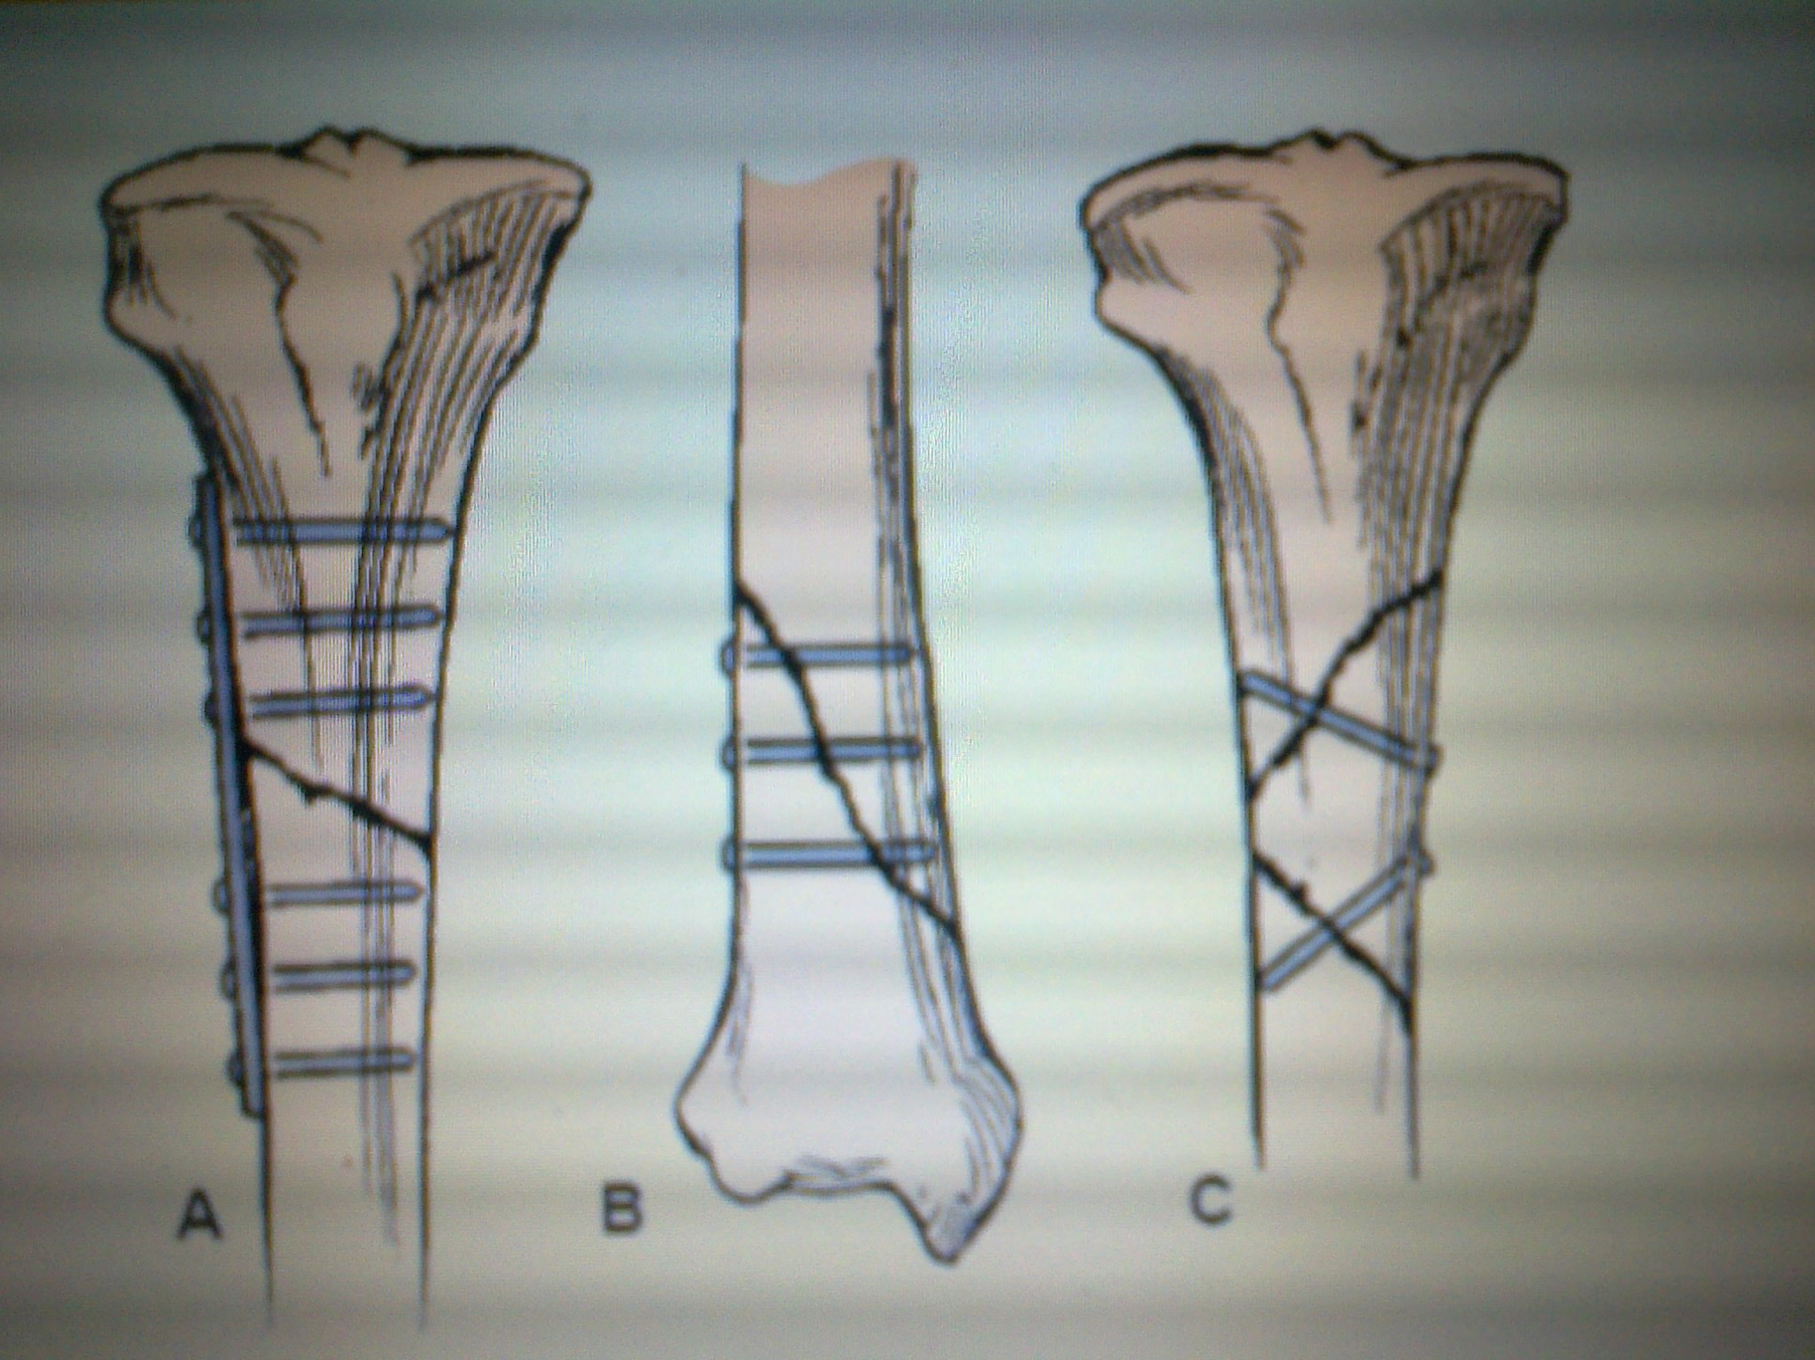
Techniques of internal fixation. (A) Plate and six screws for a transverse or short oblique fracture. (B) Screws for a long oblique or spiral fracture. (C) Screws for a long butterfly fragment.

Slide 80
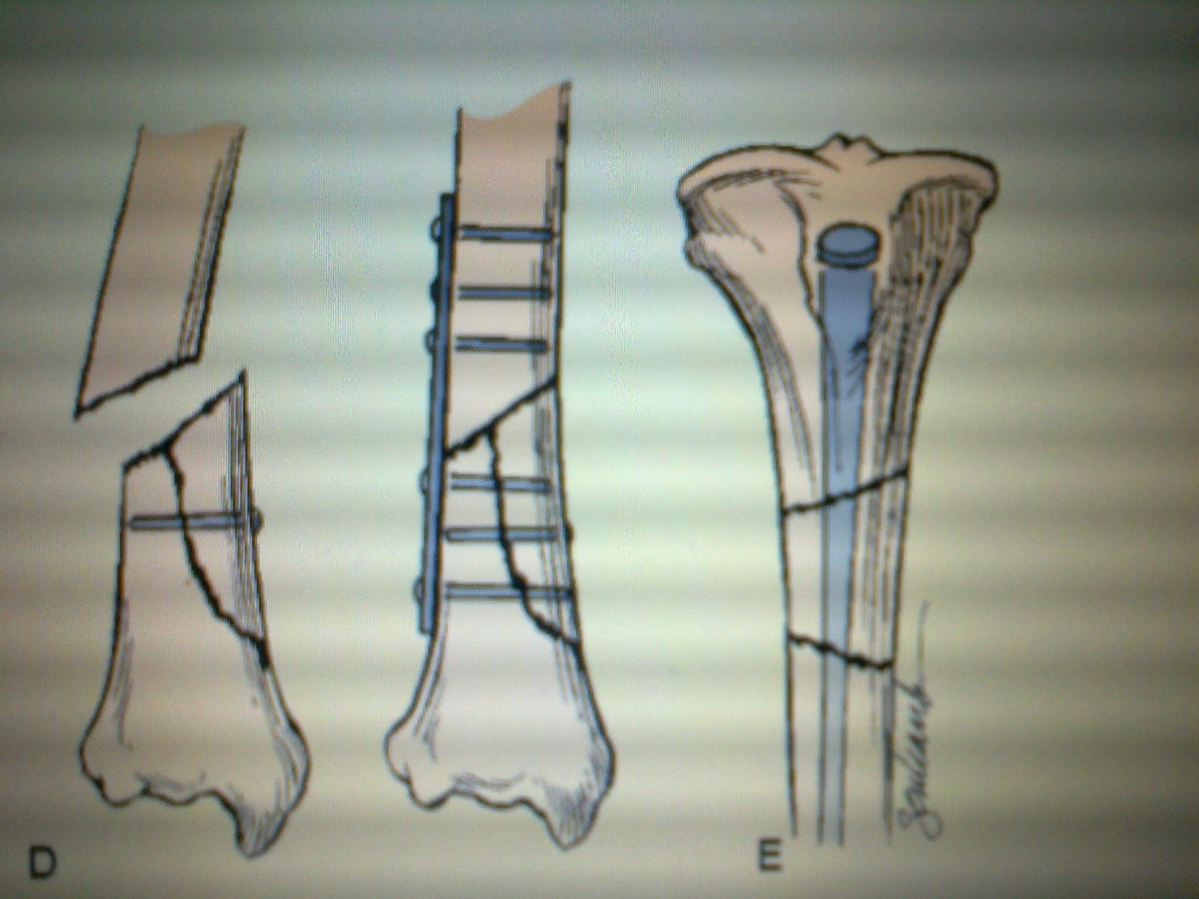
(D) Plate and six screws for a short butterfly fragment. (E) Medullary nail for a segmental fracture.

Slide 81
Immobilisation
The aim is to prevent movement of injured parts already reduced.
The bone fragments must be immobilized, or held in correct position and alignment, until union occurs.
It is accomplished through the use of:
External devices e.g. splints, plaster casts, external fixation devices or traction.
Internal devices inserted during open reduction e.g. screws, nails, plates.

Slide 82
Maintaining and restoring function
Reduction and immobilization are maintained as prescribed to promote bone and soft tissue healing.
Swelling is controlled by elevating the injured extremity and applying ice as prescribed.
Neurovascular status (circulation, movement, sensation) is monitored, and the orthopedic surgeon is notified immediately if signs of neurovascular compromise are identified.
Restlessness, anxiety, and discomfort are controlled with a variety of approaches, such as reassurance, position changes, and pain relief strategies, including use of analgesics.
Isometric and muscle-setting exercises are encouraged to minimize disuse atrophy and to promote circulation.

Slide 83
Participation in activities of daily living (ADLs) is encouraged to promote independent functioning and self-esteem.
Gradual resumption of activities is promoted within the therapeutic prescription.
With internal fixation, the surgeon determines the amount of movement and weight-bearing stress the extremity can withstand and prescribes level of activity.

Slide 84
Nursing management
PATIENTS WITH CLOSED FRACTURES
Encouraging patients with closed (simple) fractures to return to their usual activities as rapidly as possible.
Teaching patients how to control swelling and pain associated with the fracture and with soft tissue trauma and encouraging them to be active within the limits of the fracture immobilization.
Teaching exercises to maintain the health of unaffected muscles and to increase the strength of muscles needed for transferring and for using assistive devices (e.g., crutches, walker, special utensils).
With the physical therapist; teaching patients how to use assistive devices safely.
Making plans to help patients modify their home environment as needed and to secure personal assistance if necessary.

Slide 85
Patient teaching on self-care, medication information, monitoring for potential complications, and the need for continuing health care supervision.
PATIENTS WITH OPEN FRACTURES
In an open fracture, there is risk of osteomyelitis, tetanus, and gas gangrene.
The objectives of management are to
prevent infection of the wound, soft tissue, and bone and
to promote healing of soft tissue and bone.
Administration of tetanus prophylaxis if indicated.
Serial irrigation and debridement to remove anaerobic organisms.
Intravenous antibiotics are prescribed to prevent or treat infection.

Slide 86
Prompt, thorough wound irrigation and debridement in the operating room are necessary.
Devitalized bone fragments are removed.
The fracture is carefully reduced and stabilized by external fixation or intra-medullary nails.
Any damage to blood vessels, soft tissue, muscles, nerves, and tendons is treated..
Heavily contaminated wounds are left unsutured and dressed with sterile gauze to permit swelling and wound drainage.
Wound irrigation and debridement may be repeated, removing infected and devitalized tissue and increasing vascularity in the region.

Slide 87
After it has been determined that infection is not present, the wound is closed in 5 to 7 days, and all dead space is obliterated by grafting of autogenous skin or a flap.
Elevation the extremity to minimize edema.
Assessing neurovascular status frequently.
Measuring the patient’s temperature at regular intervals and monitoring the patient for signs of infection.
In 4 to 8 weeks, bone grafting may be necessary to bridge bone defects and to stimulate bone healing.

Slide 88
● ● Musculoskeletal Care Modalities
TRACTION
Traction involves a steady pull on a body part. This is a method of reduction and immobilization used to maintain fractures apart but allowing sufficient contact for healing.
Traction may be either skin or skeletal.
SKIN TRACTION
the pull is transmitted to the skin on the fractured bone. Accomplished by using adhesive or non-adhesive traction tape or other skin traction devices such as a cast, a boot, a belt
TYPES.
Buck’s Extension Traction
is skin traction to the lower leg. The pull is exerted in one plane when partial or temporary immobilization is desired. applies the pulling force in a straight line with the body part resting on the bed

Slide 89
CT
SKELETAL TRACTION
The force is directly applied to the bone by use of pulls. Accomplished by attaching pins, screws, wires
TYPES .
Balanced suspension traction: supports the affected extremity off the bed with thomas splint and allows for some patient movement without disruption of the line of pull. The pull is exerted against an opposing force provided by the weight of the body when the foot of the bed is raised
Fixed Traction: The pull is exerted against a fixed point; e.g., the tapes are tied to the crosspiece of a Thomas splint and pull the leg down

Slide 90
Other forms of traction
Manual Traction: is traction that is accomplished by a persons hands exerting a pulling force. This is temporary traction that may be used when
applying a cast,
giving skin care under a Buck’s extension foam boot, or
adjusting the traction apparatus.

Slide 91
Indications:
To reduce a fracture
Maintain alignment
Overcome and minimize muscle spasm
Correct deformities
Immobilize fractures;
Increase space between opposing surfaces.
Traction must be applied in the correct direction and magnitude to obtain its therapeutic effects.

Slide 92
At times, traction needs to be applied in more than one direction to achieve the desired line of pull. When this is done, one of the lines of pull counteracts the other. These lines of pull are known as the vectors of force. The actual resultant pulling force is somewhere between the two lines of pull.
The effects of traction are evaluated with x-ray studies, and adjustments are made if necessary.
Traction is used primarily as a short-term intervention until other modalities, such as external or internal fixation, are possible.
This reduces the risk of disuse syndrome and minimizes the length of hospitalization, often allowing the patient to be cared for in the home setting.

Slide 93
PRINCIPLES OF EFFECTIVE TRACTION
1. Whenever traction is applied, counter-traction must be used to achieve effective traction. Counter-traction is the force acting in the opposite direction
2. Traction must be continuous to be effective in reducing and immobilizing fractures.
3. Skeletal traction is never interrupted.
4. Weights are not removed unless intermittent traction is prescribed.
5. Any factor that might reduce the effective pull or alter its resultant line of pull must be eliminated:
– The patient must be in good body alignment in the center of the bed when traction is applied.
– Ropes must be unobstructed.
– Weights must hang free and not rest on the bed or floor.
– Knots in the rope or the footplate must not touch the pulley or the foot of the bed.

Slide 94
SPECIFIC CARE FOR A PATIENT ON TRACTION
maintain continuous traction and avoid adding weight.
Ensure effective traction by proper position to maintain leg in neutral position
Skin care
Monitor the skin in contact with tape or foam ,palpate area of traction tape daily to detect underlying tenderness,
Provide back care every 2hrs to avoid pressure ulcer
Keep the skin clean around pin sites in skeletal traction to avoid infections.
Nerve Pressure( peroneal nerve) care by(promoting neurovascular unction)
Regularly assess sensation and motion.
Immediately investigate any complaint of burning sensation under the traction bandage or boot.
Promptly report altered sensation or motor function.
circulation- assess for Peripheral pulses, color, capillary reﬁll, and temperature of the ﬁngers or toe, Indicators of DVT

Slide 95
ct
PROMOTING EXERCISE Patient exercises, within the therapeutic limits of the traction, assist in maintaining muscle strength and tone and in promoting circulation. Active exercises include pulling up on the trapeze, ﬂexing and extending the feet, and Isometric exercises of the immobilized extremity
promoting understanding of the treatment regimen aids in active participation
REDUCING ANXIETY Before any traction is applied, the patient needs to be informed about the procedure, its purpose, and its implications. The nurse encourages the patient to participate in decisions that affect care.
achieving a maximum level of comfort by providing firm mattress and frequent positioning, by making sure the bed linens remain wrinkle-free and dry.
monitoring and managing potential complications i.e DVT, pneumonia, constipation ,urinary stasis

Slide 96
CASTS
Def: A cast is a rigid external immobilizing device that is molded to the contours of the body.
The purposes of a cast are
to immobilize a reduced fracture,
To correct a deformity,
to apply uniform pressure to underlying soft tissue, or
to support and stabilize weakened joints.
Casts permit mobilization of the patient while restricting movement of a body part.
The skin should be intact, clean and well padded before a cast is applied to avoid risks of infection.
Casts are molded over the affected body part after closed reduction has been done.

Slide 97
TYPES OF CASTS
Short arm cast: Extends from below the elbow to the palmar crease.
Long arm cast: Extends from the upper level of the axillary fold to the proximal palmar crease. The elbow usually is immobilized at a right angle.
Short leg cast: Extends from below the knee to the base of the.
The Long leg cast: Extends from the junction of the upper and middle third of the thigh to the base of the toes. The knee may be slightly ﬂexed.
Walking cast: A short or long leg cast reinforced for strength.
Body cast: Encircles the trunk.
Shoulder spica cast: A body jacket that encloses the trunk and the shoulder and elbow.
Hip space cast :Encloses the trunk and a lower extremity.

Slide 98
Casting materials
1) Non-plaster: fiberglass casts
They are water-activated polyurethane materials having the versatility of plaster but are lighter in weight, stronger, water resistant, and durable. .
Non-plaster casts
are porous and therefore diminish skin problems.
They do not soften when wet, which allows for hydrotherapy when appropriate.
When wet, they are dried with a hair drier on a cool setting;
They are used for non-displaced fractures with minimal swelling and for long-term wear.

Slide 99
2) Plaster
Rolls of plaster bandage are wet in cool water and applied smoothly to the body. A crystallizing reaction occurs, and heat is given off.
The crystallization process produces a rigid dressing. The speed of the reaction varies from a few minutes to 15 to 20 minutes. After the plaster sets, the cast remains wet and soft.
While damp, the cast can be dented. Therefore, it must be handled with the palms of the hand and not allowed to rest on hard surfaces or sharp edges. Cast dents may press on the skin causing irritation and skin breakdown.
The plaster cast requires 24 to 72 hours to dry completely, depending on its thickness and the environmental drying conditions

Slide 100
Specific casts mngt considerations
1. Arm casts
Nursing interventions
Elevating the immobilized arm to control swelling.
When the patient is lying down, the arm is elevated so that each joint is positioned higher than the preceding proximal joint
A sling may be used when the patient ambulates.
To prevent pressure on the cervical spinal nerves, the sling should distribute the supported weight over a large area and not on the back of the neck.
Encouraging the patient to remove the arm from the sling and elevate it frequently.
6.Prevent circulatory problems(volkmans contractures)through frequent neurovascular checks

Slide 101
2. Leg casts
Nursing interventions
Supporting the patient’s leg on pillows to heart level to control swelling and applies ice packs as prescribed over the fracture site for 1 or 2 days.
Teaching the patient to elevate the casted leg when seated.
The patient should also assume a recumbent position several times a day with the casted leg elevated to promote venous return & control swelling.
Assessing circulation by observing the color, temperature, and capillary refill of the exposed toes.
Nerve function is assessed by observing the patient’s ability to move the toes and by asking about the sensations in the foot. Numbness, tingling, and burning may be caused by peroneal nerve injury from pressure at the head of the fibula.
When the cast is hard and dry, the nurse teaches the patient how to transfer and ambulate safely with assistive devices (eg, crutches, walker).
If weight bearing is allowed, the cast is reinforced to withstand the body weight.

Slide 102
3. Body or spica casts
Casts that encase the trunk (body cast) and portions of one or two extremities (spica cast) require special nursing strategies.
Nursing interventions
Preparing and positioning the patient, assisting with skin care and hygiene, and monitoring for cast syndrome.
Explaining the procedure helps reduce the patient’s apprehension about being encased in a large cast.
Reassuring the patient that several people will provide care during the application.
Medications for pain relief and relaxation administered before the procedure enable the patient to cooperate during application of the cast.

Slide 103
The pillows are positioned next to each other, because spaces between pillows allow the damp cast to sag, become weak, and possibly break.
A pillow is not placed under the head and shoulders of a patient in a body cast while the cast is drying, because doing so causes pressure on the chest.
Turning the patient as a unit toward the uninjured side every 2 hours to relieve pressure and to allow the cast to dry.
Avoid twisting the patient’s body within the cast.
Cracking or denting of the cast is prevented by supporting the patient on a firm mattress and with flexible, waterproof pillows until the cast dries.
Encouraging the patient to assist in the repositioning, if not contraindicated, by use of the trapeze or bed rail.

Slide 104
Turning the patient to a prone position, twice daily if tolerated, to provide postural drainage of the bronchial tree and to relieve pressure on the back.
Placing a pillow lengthwise under the dorsa of the feet or allowing the toes to hang over the edge of the bed to prevent the toes from being forced into the mattress.
Inspecting the skin around the edges of the cast frequently for signs of irritation.
The skin can be bathed and massaged by reaching under the cast edges with the fingers.

Slide 105
To protect the cast from soiling, the nurse can insert clean dry plastic sheeting under the cast and over the cast edge before elimination by the patient.
Teaching the family members how to care for the patient at home on providing hygienic and skin care, ensuring proper positioning, preventing complications, and recognizing symptoms that should be reported to the health care provider.

Slide 106
Managing a patient with splints and braces
Contoured splints of plaster or pliable thermoplastic may be used for conditions
that do not require rigid immobilization,
for those in which swelling may be anticipated, and
for those that require special skin care.
The splint must be well padded to prevent pressure, skin abrasion, and skin breakdown.
The splint is overwrapped with an elastic bandage applied in a spiral fashion and with pressure uniformly distributed so that the circulation is not restricted.
Assessment of the neurovascular status and skin integrity of the splinted extremity should be done frequently.

Slide 107
For long-term use, braces (orthoses) are used to
provide support,
control movement, and
prevent additional injury.
Braces may be constructed of plastic materials, canvas, leather, or metal.
The orthotist adjusts the brace for fit, positioning, and motion.
The nurse
helps the patient learn to apply the brace and to protect the skin from irritation and breakdown.
assesses neurovascular integrity and comfort when the patient is wearing the brace,
encourages the patient to wear the brace as prescribed, and
reassures the patient that minor adjustments of the brace by the orthotist will increase comfort and minimize problems associated with its long-term use.

Slide 108
Complications of fractures
Two categories—early and delayed .
Early complications include
shock,
fat embolism,
Compartment syndrome,
deep vein thrombosis,
Thrombo-embolism(pulmonary embolism),
disseminated intravascular coagulopathy, (DIC),
infection.
Delayed complications include
delayed union and nonunion,
avascular necrosis of bone,
reaction to internal fixation devices,
complex regional pain syndrome (formerly called reflex sympathetic dystrophy), and
heterotrophic ossification.

Slide 109
Nursing intervention to prevent fracture complications
1) Preventing trauma and injury/promoting self-care
Advise the patient on
Self transfer technique
Proper use of ambulatory aids
Proper positioning of the affected extremity
Pain and discomfort relief measures
2) Maintaining strength and mobility/promoting activity
Encourage the patient to perform muscle toning exercises on a regular basis
Encourage and assist the patient ot resume to normal functioning of all ADL within limits of immobilization.

Slide 110
3) Promoting comfort
Admininister the prescribed antispasmodics
Reposition the patient frequently with the prescribed position to avoid prolonged pressure over bony prominences
Apply ice compresses as ordered to the affected part to reduce swelling and relieve pain
4) Maintaining intact neurovascular status and tissue perfusion
Palpating for warmth and observing for colour in the affected part
Assessing for presence of positive Homan’s sign
Instituting measures to promote venous blood flow
Elevate the extremity to a level above the heart
Use proper positioning techniques
Avoid external compression on pressure sites
Encourage ROM and isometric exercises

Slide 111
5) Preventing infection
Observe aseptic technique during dressing changes to prevent infection
Monitoring drains for correct placement
Performing pin site care to prevent infection
Providing and encouraging the patient to eat a well balanced diet to provide nutritional elements necessary for wound healing.
6)Maintaining skin integrity
Identifying skin areas at risk especially over bony prominences
Inspecting the skin for signs of pressure
Turning the patient 2 hourly while fracture immobilisation using a turning sheet

Slide 112
Soft tissue injuries
Contusion is a soft tissue injury produced by blunt force, such as a blow, kick, or fall.
Many small blood vessels rupture and bleed into soft tissues (ecchymosis, or bruising). A hematoma develops when the bleeding is sufficient to cause an appreciable collection of blood.
Local symptoms (pain, swelling, and discoloration) are controlled with intermittent application of cold. Most contusions resolve in 1 to 2 weeks.
2. A strain is a “muscle pull” caused by overuse, overstretching, or excessive stress. Strains are microscopic, incomplete muscle tears with some bleeding into the tissue.
The patient experiences soreness or sudden pain, with local tenderness on muscle use and isometric contraction.

Slide 113
3. A sprain is an injury to the ligaments surrounding a joint that is caused by a wrenching or twisting motion.
The function of a ligament is to maintain stability while permitting mobility. A torn ligament loses its stabilizing ability.
Blood vessels rupture and edema occurs; the joint is tender, and movement of the joint becomes painful.
The degree of disability and pain increases during the first 2 to 3 hours after the injury because of the associated swelling and bleeding.
An x-ray should be obtained to rule out bone injury.
4. Avulsion fracture (in which a bone fragment is pulled away by a ligament or tendon) may be associated with a sprain.

Slide 114
Treatment of contusions, strains, and sprains consists of
The acronym RICE—Rest, Ice, Compression, Elevation)
Rest prevents additional injury and promotes healing.
Moist or dry cold applied intermittently for 20 to 30 minutes during the first 24 to 48 hours after injury produces vasoconstriction, which decreases bleeding, edema, and discomfort. Care must be taken to avoid skin and tissue damage from excessive cold.
An elastic compression bandage controls bleeding, reduces edema, and provides support for the injured tissues.
Elevation controls the swelling.
If the sprain is severe, surgical repair or cast immobilization may be necessary so that the joint will not lose its stability. The neurovascular status (circulation, motion, sensation) of the injured extremity is monitored frequently.

Slide 115
JOINT DISORDERS
RHEUMATOID ARTHRITIS Rheumatoid Arthritis is a systemic inflammatory diseases affecting synovial joints.
Pathophysiology The autoimmune reaction within synovial membrane leads to an inflammatory process, that damages or irritates the joint tissues.
Continued inflammation leads to thickening of the synovium especially where it joins the articular cartilage.
At this point, fibrin develops into a granulation tissue known as pannus which destroys cartilage and erodes the bones. This leads to adhesions between joint surfaces and fibrous or bony ankylosis. Pain occurs as a result of cartilage degeneration due to erosion.

Slide 116
Clinical features of arthritis
Early Signs | Late Signs | Other Signs
Warm, swollen and painful joints | Pallor | Increasing pain
Morning stiffness lasting 30 minutes | Anaemia | Paraesthesia
Pain at rest and with movement | Joint deformities | Dislocation
Weight loss, Fatigue, malaise | Contractures, rheumatoid nodules

Slide 117
Diagnosis
This is made from the history and presence of :
Stiffness, joint pain and swelling
Narrowing of the joint spaces seen on x-ray
Mild leucocytosis
Rheumatoid factor
The red blood cell count and CD4 complement component are decreased
Arthritis Assessment
Inspection and palpation of the same joints on both sides of the body for asymmetry, skin color, size, shape, tenderness, swelling
Limitation of active joint movement

Slide 118
Medical management
Administering of medications e.g. indocid 50-75mg tds, naprosyn 100mg bd
Steroids i.e predinsolone reduce inflammation
Disease modifying anti-rheumatoid drugs i.e methotrexate,sulfasalzine slow progression of disease
Immunosupressants i.e cyclosporine
Surgical procedures include synovectomy (excision of the synovial membrane), tenorrhaphy (suturing a tendon), arthrodesis (surgical fusion of the joint), and arthroplasty (surgical repair and replacement of the joint).

Slide 119
Nursing interventions
1) Comfort/ Proper positioning of limb
Providing heat or cold treatments on the affected joints according
Encouraging the use of resting splints
2) Independence
Assist in activities of daily living as needed
Encourage use of supportive devices e.g. trapeze to move up the bed
3) Reducing fatigue by for example, providing frequent rest periods. Instruct patient on how to conserve energy.
4) Mobility and prevention of injury by:
Assessing all joints for signs of inflammation and deformity
Avoiding positions that can lead to formation of contractures
Encouraging patient to wear flat shoes and not slippers for ambulation
5. Nutrition-
with emphasis on foods high in vitamins, protein, and iron for tissue building and repair. For the extremely anorexic patient, small, frequent feedings
6. patient education on the disease

Slide 120
Degenerative joint disease(osteoarthritis)
Def: A condition affecting one or more joints characterised by degeneration of joint tissue or a non-inflammatory condition of the joint characterised by degeneration of joint tissue.
Pathophysiology
The onset is slow with erosion of articular cartilage, thickening of sub-chondral bone and formation of osteophytes or bone spurs.
. The area of the cartilage becomes soft and the surface becomes rough and cracks. Eventually the cartilage is destroyed and the underlying bone goes through a remodeling process.
Osteophytes or bone spurs appear at the joint margin at the sites of attachment. These may break off and appear in the joints as joint mice.

Slide 121
Classification
Primary (idiopathic)…no prior event or disease related to the OA, and
Secondary….resulting from previous joint injury or inflammatory disease.
Risk factors
Increased age
Obesity
Previous joint damage
Repetitive use (occupational or recreational)
Anatomic deformity
Genetic susceptibility

Slide 122
Clinical Features
Pain in affected joint (due to an inflamed synovium, stretching of the joint capsule or ligaments) which increases with weather changes or increased activity
Muscle spasms
Stiffness (morning or on awakening)
Shortening ligaments
Joint deformity
Functional impairment(due to pain on movement and limited motion caused by structural changes in the joints.
Characteristic bony nodes may be present; on inspection and palpation(usually painless, unless inflammation is present.
Diagnosis
Based on evaluation and history
X-ray films show narrowing of joint space

Slide 123
Medical management
NOTE: no treatment halts the degenerative process, certain preventive measures can slow the progress if undertaken early enough. These include
weight reduction,
prevention of injuries,
perinatal screening for congenital hip disease, and
ergonomic modifications.
Conservative treatment measures include the
use of heat,
weight reduction,
joint rest and
avoidance of joint overuse,
orthotic devices to support inflamed joints (splints, braces),
isometric and postural exercises, and aerobic exercise.
Occupational and physical therapy can help the patient adopt self-management strategies.

Slide 124
Pharmacologic management
Directed toward symptom management and pain control.
Use of analgesics, opioids and intra-articular corticosteroids.
Newer therapeutic approaches include glucosamine and chondroitin, which are thought to improve tissue function and retard breakdown of cartilage
Viscosupplementation, the intra-articular injection of hyaluronic acid, is thought to improve cartilage function and retard degradation; it may also have some anti-inflammatory effects

Slide 125
Surgical management
osteotomy (to alter the force distribution in the joint)
arthroplasty.
Viscosupplementation (the reconstitution of synovial fluid viscosity).
Tidal irrigation (lavage) of the knee involves the introduction and then removal of a large volume of saline into the joint through cannulas.

Slide 126
Post-operative management
Proper positioning of the patient in bed to avoid hip dislocation. A wedge pillow maybe used between the limbs.
Vital signs observation four hourly to assess the patient's progress.
Oxygen may be administered for the first six hours to improve perfusion.
Observations are of the incision site for bleeding and drainage if drain is in situ. If the drainage is minimal the drains should be removed 48 to 72 hours post operatively.
Pain management control should be maintained throughout the recovery period e.g. pethidine 75mg IV eight hourly and as needed followed by oral diclofenac 100mg bd for 14-21 days.

Slide 127
Ambulation. The patient starts on passive exercises as soon as the pain is controlled to avoid complications e.g. deep venous thrombosis.
Nutrition. patients may be allowed to take oral sips six hours after surgery.
If they had intravenous infusions running, these should be allowed to go through and the input and output chart should be maintained to monitor fluids.
The patient should be allowed to feed on a well balanced diet soon after they can tolerate fluids.

Slide 128
Nursing management
1. Relief of pain by
resting the involved joints,
advising the patient to avoid activities that precipitate pain,
use of heat,
analgesics and anti-inflammatory drugs,
The use of correct body mechanics and assistive devises
avoidance of heavy weight bearing is also helpful.
2. Optimizing functional ability
Canes or other assistive devices for ambulation should be considered.
Exercises such as walking should be begun in moderation and increased gradually.
Progressive range of motion exercises, avoiding flexion deformities

Slide 129
JOINT DISLOCATION
Def: a condition in which the articular surfaces of the bones forming the joint are no longer in anatomic contact. The bones are literally “out of joint.”
A sub-luxation is a partial dislocation of the articulating surfaces.
Traumatic dislocations are orthopedic emergencies because the associated joint structures, blood supply, and nerves are distorted and severely stressed.
If the dislocation is not treated promptly, avascular necrosis (tissue death due to anoxia and diminished blood supply) and nerve palsy may occur.

Slide 130
Dislocations may be
congenital, or present at birth (most often the hip);
spontaneous or pathologic,
caused by disease of the articular or peri-articular structures;
traumatic, resulting from injury in which the joint is disrupted by force.
Signs and symptoms of a traumatic dislocation are
pain,
change in contour of the joint,
change in the length of the extremity,
loss of normal mobility, and
change in the axis of the dislocated bones.
X-rays confirm the diagnosis

Slide 131
Medical management
Immobilization of the affected joint while the patient is transported to the hospital.
Prompt reduction of the dislocation i.e., (displaced parts are brought into normal position) to preserve joint function.
Analgesia, muscle relaxants, and possibly anesthesia are used to facilitate closed reduction.
The joint is immobilized by bandages, splints, casts, or traction and is maintained in a stable position.
Neurovascular status is monitored.
After reduction, if the joint is stable, gentle, progressive, active and passive movement is begun to preserve range of motion (ROM) and restore strength.
The joint is supported between exercise sessions.

Slide 132
Nursing management
Providing comfort,
Evaluating the patient’s neurovascular status,
Protecting the joint during healing.
Teaching the patient how to manage the immobilizing devices and how to protect the joint from re-injury.

Slide 133
AMPUTATION
Def: removal of a body part, usually a limb or part of a limb
Amputation is often necessary as a result of:
Progressive peripheral vascular disease(often a sequelae of DM)
Severe burns
Severe congenital deformities
malignant tumours
fulminating gas gangrene,
trauma (crushing injuries, burns, frostbite, electrical burns),
Chronic osteomyelitis.
Amputation is used to
relieve symptoms,
improve function,
save or improve the patient’s quality of life.

Slide 134
Levels of amputation
Amputation is performed at the most distal point that will heal successfully. The site of amputation is determined by two factors:
circulation in the part, and
functional usefulness (i.e., meets the requirements for the use of the prosthesis).
The circulatory status of the extremity is evaluated through
physical examination
Doppler flow-metry,
Segmental blood pressure determinations, and
Transcutaneous partial pressure of oxygen (PaO2)
Angiography (if revascularization is considered an option).

Slide 135
The objective of surgery is to conserve as much extremity length as possible. Preservation of knee and elbow joints is desired.
Below-knee amputations are preferred to above-knee amputations because of the importance of the knee joint and the energy requirements for walking.
Knee disarticulations are most successful with young, active patients who are able to develop precise control of the prosthesis.
When above-knee amputations are performed, all possible length is preserved, muscles are stabilized and shaped, and hip contractures are prevented for maximum ambulatory potential.
Most people who have a hip disarticulation amputation must rely on a wheelchair for mobility.
A staged amputation may be used when gangrene and infection exist

Slide 136
Pre-operative care
the nurse must evaluate the neurovascular and functional status of the extremity, the circulatory status nutritional status, Any concurrent health problems , cardiac insufficiency, chronic respiratory problems, diabetes mellitus.
Assist the patient to undergo investigations and i.e blood grouping and crossmatching
provide psychological support that will help to deal with sudden change in body image.
Always give good nutrition, high in vitamins and proteins
Correct and monitor Hb,
Teach the patient how to use assistive devices such as crutches
Involve the patient in exercise programmes.
Complications
They include hemorrhage, infection, skin breakdown, phantom limb pain and joint contracture.

Slide 137
Post-operative care
Surgical pain can be effectively controlled with opioid analgesics i.e pethidine
Immediately after surgery, the patient should be closely monitored for hemorrhages, vital signs fluctuations .
Ensure good wound drainage as well as proper wound dressing
Administration of antibiotics to decrease sepsis
Physiotherapy to prevent the development of contractures.
. Phantom pain (when a patient reports pain in an area distal to a point of amputation) often occurs as a result of the missing limb and psychotherapy is recommended. i.e a patient may report pain on missing toes.

Slide 138
Care of the skin at the stump area,
help the patient to achieve physical mobility by Muscle strengthening and ROM exercise, position changes, elevation of extremity.
Enhancing healing by gentle handling of the residual limb, control of residual limb edema through rigid or soft compression dressings, and use of aseptic technique in wound care to avoid infection.
Education on use of prostheses
Monitor for potential complicationi 1.e infections
Rehabilitation of the patient
psychological support in accepting the sudden change in body image
The patient is encouraged to be an active participant in self-care.
dealing with the stresses of hospitalization,
Modification of lifestyle.

Slide 139
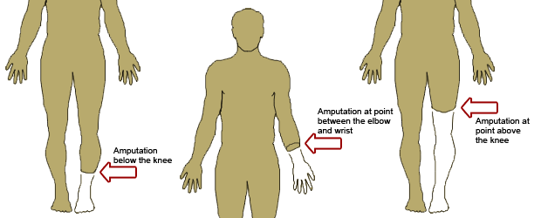
Levels of amputation

Slide 140
GOUT
Def: heterogeneous group of conditions related to a genetic defect of purine metabolism resulting in hyperuricemia and deposition of monosodium urate crystalsuric acid/ in joints or soft tissue causing inflamation.
In human blood, uric acid concentrations are between 3.6 and 8.3 mg/dL
Symptoms: joint pain that starts with distal joints and swelling. Acute athritis big toe mostly affected.
tophi (crystalline deposits accumulating in articular tissue,
Saturation of uric acid in the human blood stream may result in one form of kidney stones
Aggravated by infections, cold weather and consumption of meals rich in purines

Slide 141
The four phases of gout include
1. asymptomatic hyperurecemia (early phase)
2, acute gouty arthritis (acute phase)
3. intercritical gout (remission)
4. chronic tophaceous gout (chronic gout)
Peak incidence occurs in patients 30 to 50 years.
Condition more common in men than women.

Slide 142
Causes of gout
Raised levels of uric acid.
High intake of purine rich foods e.g. offal foods, red meat and shell fish.
High alcohol intake particularly beer and wine can increase uric acid levels in the body. Heavy alcohol intake is a risk factor that often precedes a gout attack.
Genetics- Gout runs in families from one generation to the next. This disapproves the common notion that gout is mainly caused by excessive eating (nyama choma) and drinking.
Obesity- contributory factor to gout.
High blood pressure- usually linked to high uric acid levels and also linked to conditions such as heart disease
Drugs or medications- e.g. Diuretics, aspirin & chemotherapy treatment for cancer can lead to increase in uric acid levels
Notes:
.

Slide 143
Management
Mainly preventive.
Advice on how to avoid acute gout attacks.
Anti-gout medication comes in two forms.
Pain-controlling medication such as indocid, diclofenac and aspirin at a high dose.
Colechine used in acute attack
Medication that acts to decrease the production of uric acid e.g. allopurinol, probencid.
Advice to avoid over indulgence on roast meat, organ meat (such as liver), baked chicken as these are high in purines.
Drinking lots of fluids to facilitate the secretion of uric acid through the kidneys.

Slide 144
RAT
1. Buck’s extension traction is:
A. Skin traction to the lower leg.
B. Applied as cervical head halter.
C. Traction is applied directly to the bone
D. Tongs applied to the head
2. Most common pathogenic organism found in osteomyelitis:
A. Escherichia coli
B. Proteus
C. Pseudomonas species
D. Staphylococcus aureus
3. True about osteoclasts:
A. Involved in bone formation by secreting bone matrix.
B. Mature bone cells involved in bone-maintenance functions
C. Multinuclear cells involved in destroying, resorbing, and remolding bone.
D. Membrane in joint that secretes lubricating fluid

Slide 145
4. A surgical procedure done to relieve pressure in compartment syndrome:
A. Open reduction with internal fixation (ORIF)
B. Meniscectomy
C. Fasciotomy
D. Arthroplasty
5. A sequestrum is
A. A piece of soft dead tissue
B. A piece of dead skin
C. A piece of a dead bone
D. retained swab
6. Malunion of a fracture is
A. A fracture which unites in a position of deformity
B. Delayed union of a fracture
C. Non-union of a fracture
D. Followed by pseudoarthrosis
7. Fractured bone has the greatest capacity to remodel in a
A. 6 year old male Little League player
B. 20 year old female gymnast
C. 35 year old male athlete
D. 55 year old postmenopausal woman

Slide 146
8. Acute osteomyelitis usually begins at
A. Epiphysis
B. Diaphysis
C. Metaphysic
D. Any of the above
9. Osteomalacia predominantly affects
A. Spine
B. Pelvis
C. Skull bones
D. Metartarsals
10. Spiral fracture is due to
A. Blunt trauma
B. Axial compression
C. Twist
D. Direct impact

Slide 147
ANSWERS
1. A
2. D
3. C
4. C
5. C
6. A
7. A
8. B
9. A
10. C

Slide 148
The end
Thanks
All the best in your exams

